Slide 1

Interaction between
a mobile device and a ROS host
Tutor：Prof. Lin ZHANG、Dr. Zhong WANG
Team member：雷翔、卢嘉霖、黄晨冉

Slide 2
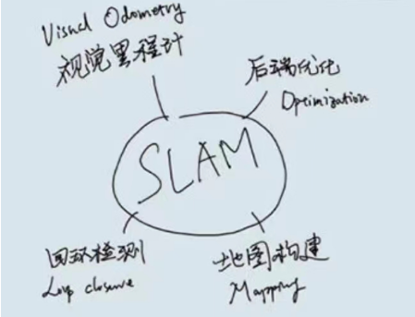
SLAM introduction
Topic：Interaction between a mobile device and a ROS host
SLAM (Simultaneous Localization and Mapping), is the process by which a moving object calculates its own position while constructing a map of its environment based on information from sensors
SLAM systems are generally divided into five modules:
sensor data, visual odometry, backend opitimization, mapping, loopback detection.
SLAM is divided into two main categories:
Lidar SLAM: uses 2D or 3D LiDAR and is suitable for indoor robotics and drones.
Visual SLAM: Utilizes the rich texture information in the environment and has strong scene recognition capabilities.
Notes:
传感器读取数据后，视觉里程计估计两个时刻的相对运动（Ego-motion），后端处理视觉里程计估计结果的累积误差，建图则根据前端与后端得到的运动轨迹来建立地图，回环检测考虑了同一场景不同时刻的图像，提供了空间上约束来消除累积误差。
传感器数据：主要用于采集实际环境中的各类型原始数据。包括激光扫描数据、视频图像数据、点云数据等。
视觉里程计：主要用于不同时刻间移动目标相对位置的估算。包括特征匹配、直接配准等算法的应用。
后端：主要用于优化视觉里程计带来的累计误差。包括滤波器、图优化等算法应用。
建图：用于三维地图构建。
回环检测：主要用于空间累积误差消除

Slide 3
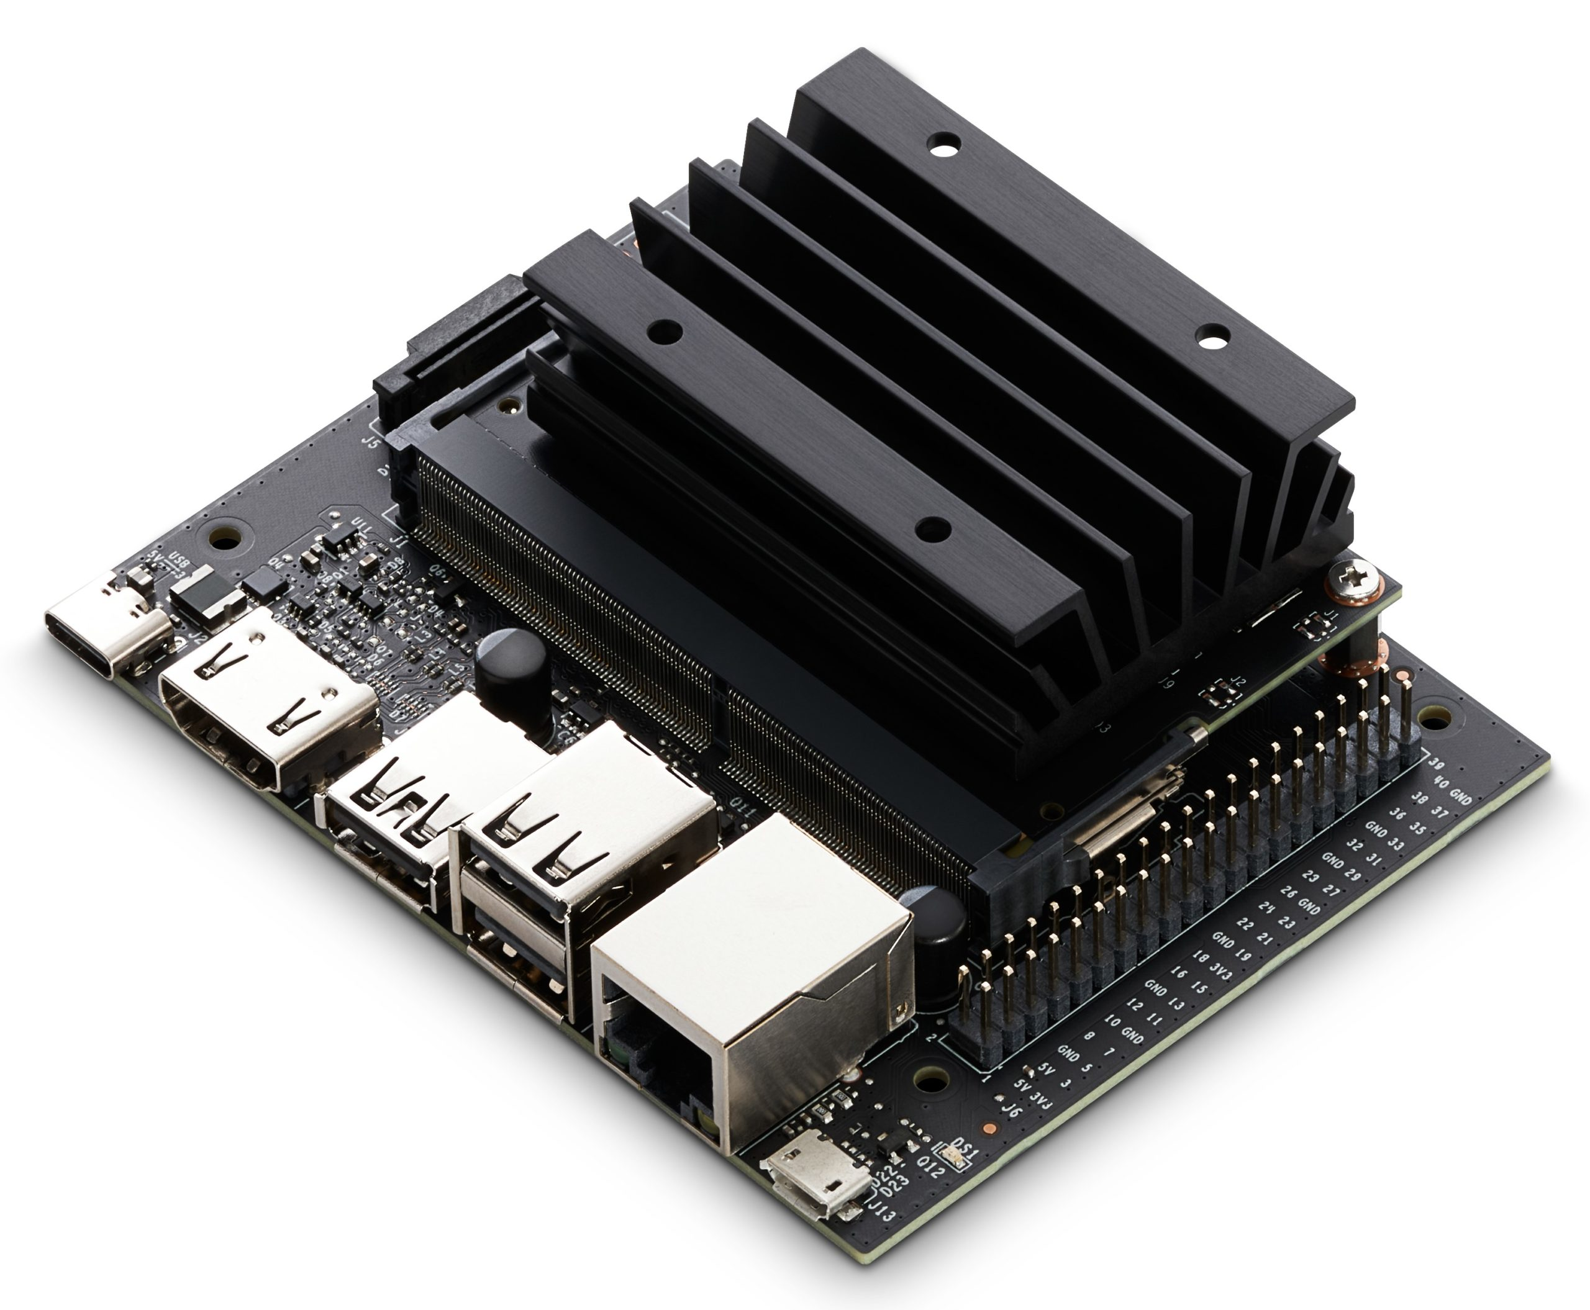

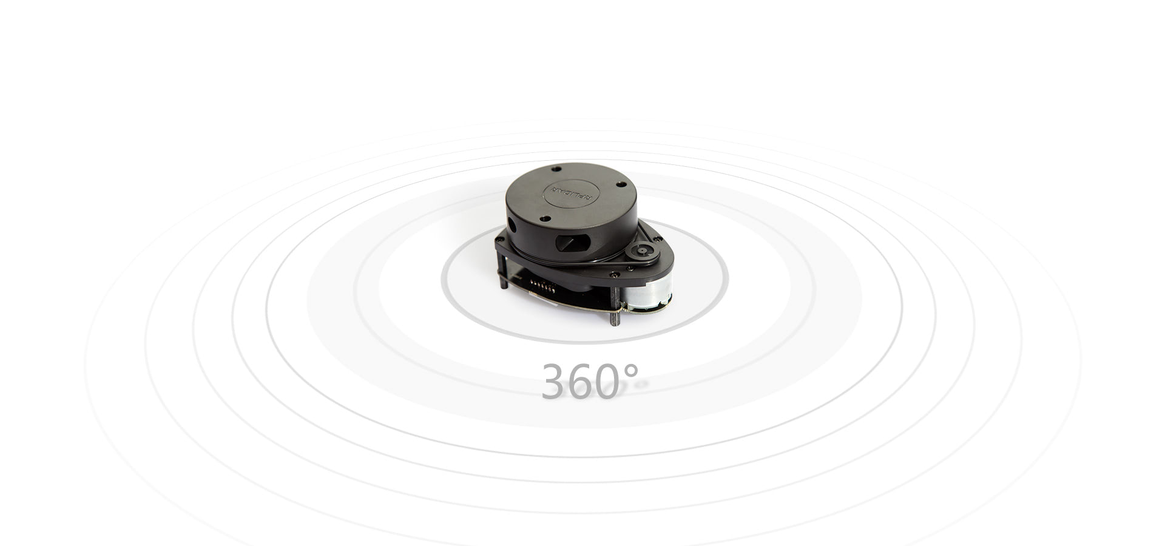
ROS and mobile building
ROS
Mobile device
NVIDIA Jetson nano
/play_bag
iviz
/cartographer_node
/scan
/rplidar_node
ROS data
/cartographer_occupancy_grid_node
iviz_roslib
iviz_xmlrpc
RPLIDAR A1
cartographer_node: subscribes to sensor data, runs algorithm, generates submap_list
cartographer_occupancy_grid_node: subscribes to the submap_list, publishes the grid map.
iviz_roslib: subscribe to raster maps, encapsulate network protocols, implement host-client data communication.
iviz_xmlrpc: partially implement HTTP requests and XML-RPC calls.
iviz: accepts raster map data and presents it as a visualization.

Slide 4
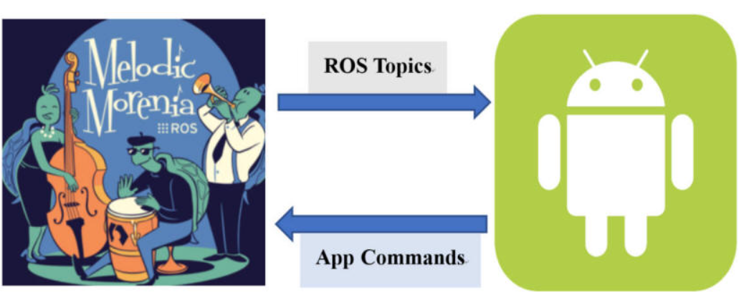
Project introduction
topic：Interaction between a mobile device and a ROS host
Functionality:
1. Start a SLAM application (Google cartographer) in the ROS system
2. Combined with hardware, self-purchase RPLIDAR A1M8 LiDAR to realize autonomous map building
3. The use of Sprint Lidar to generate 3D point cloud map
4. The cartographer accepts the radar data and sends it to the mobile app after processing
5. App and cartographer real-time synchronization
6. Display 2D grid map and 3D point cloud
7. Switch between 2D and 3D map on mobile
8. Exit SLAM program from APP

Slide 5
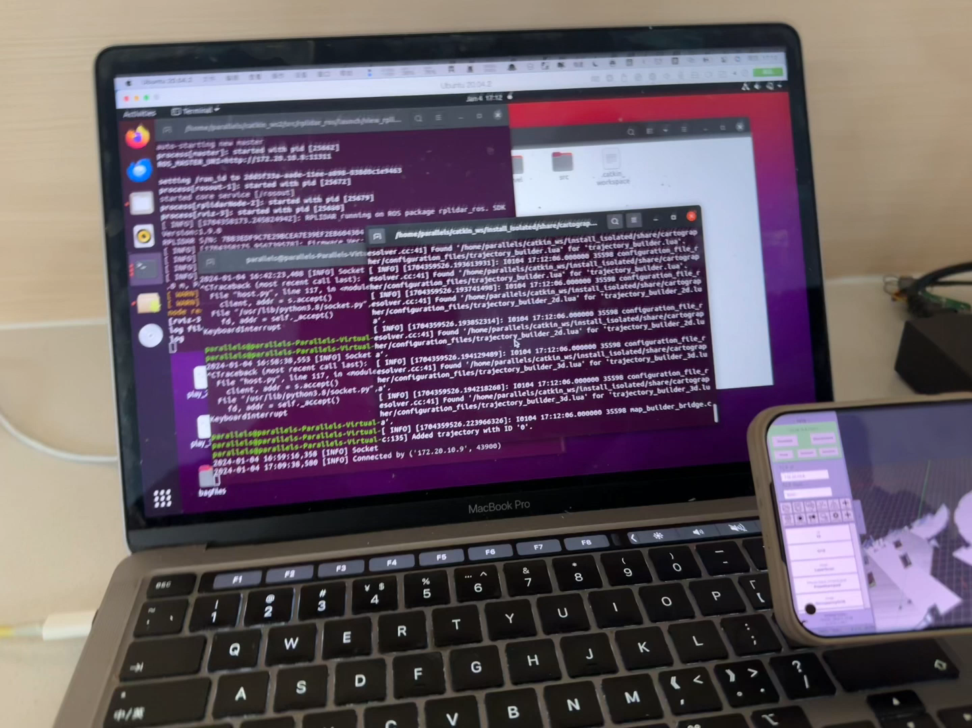
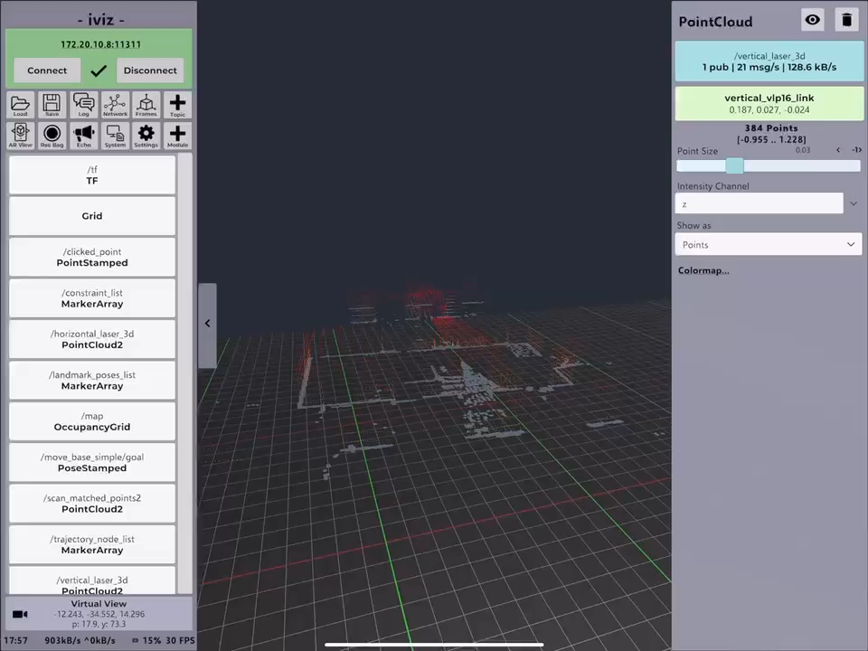
ROS communication with mobile
2D grid map
3D point clouds
We complete the communication between ROS and mobile, which can receive and display 2D grid maps and 3D point clouds on mobile.

Slide 6
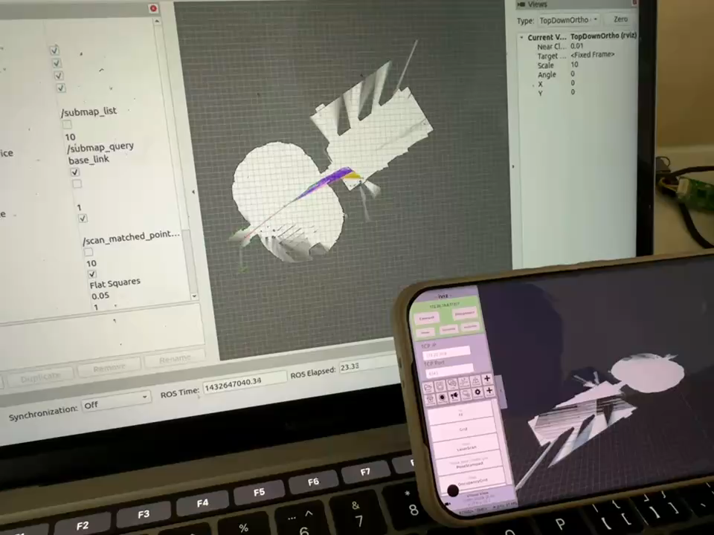
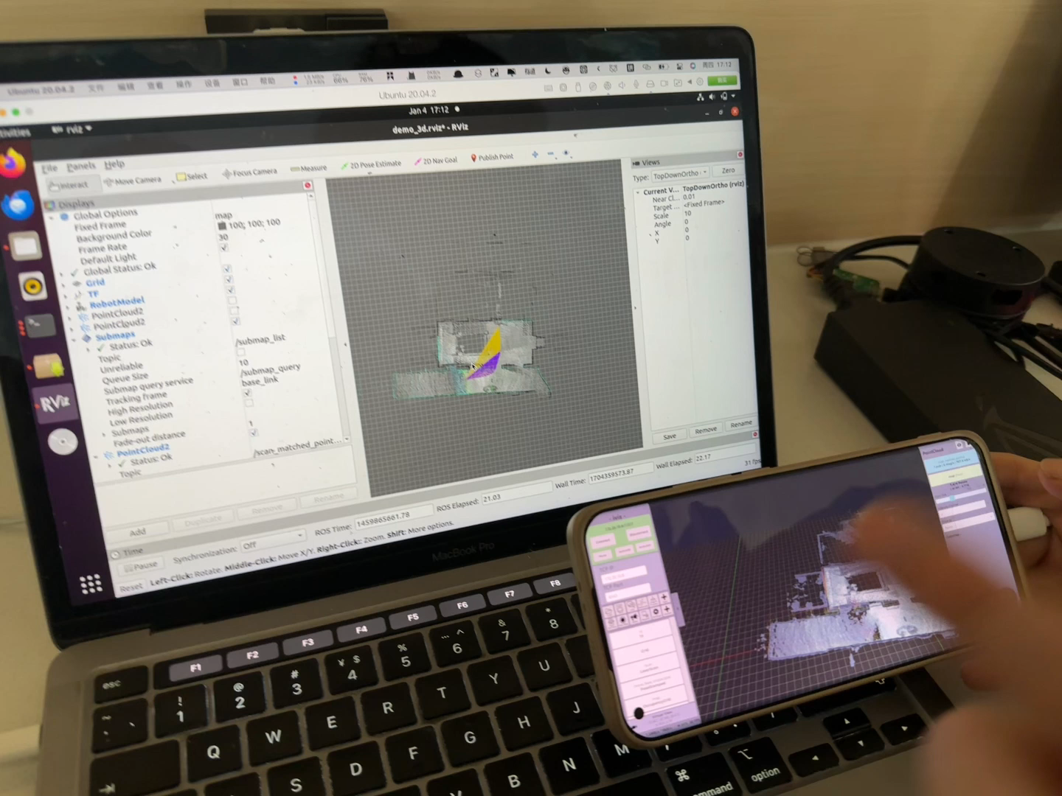
2D and 3D image switching
2D -> 3D
3D -> 2D
We complete the switching of 2D and 3D image using ROS and mobile interaction.

Slide 7
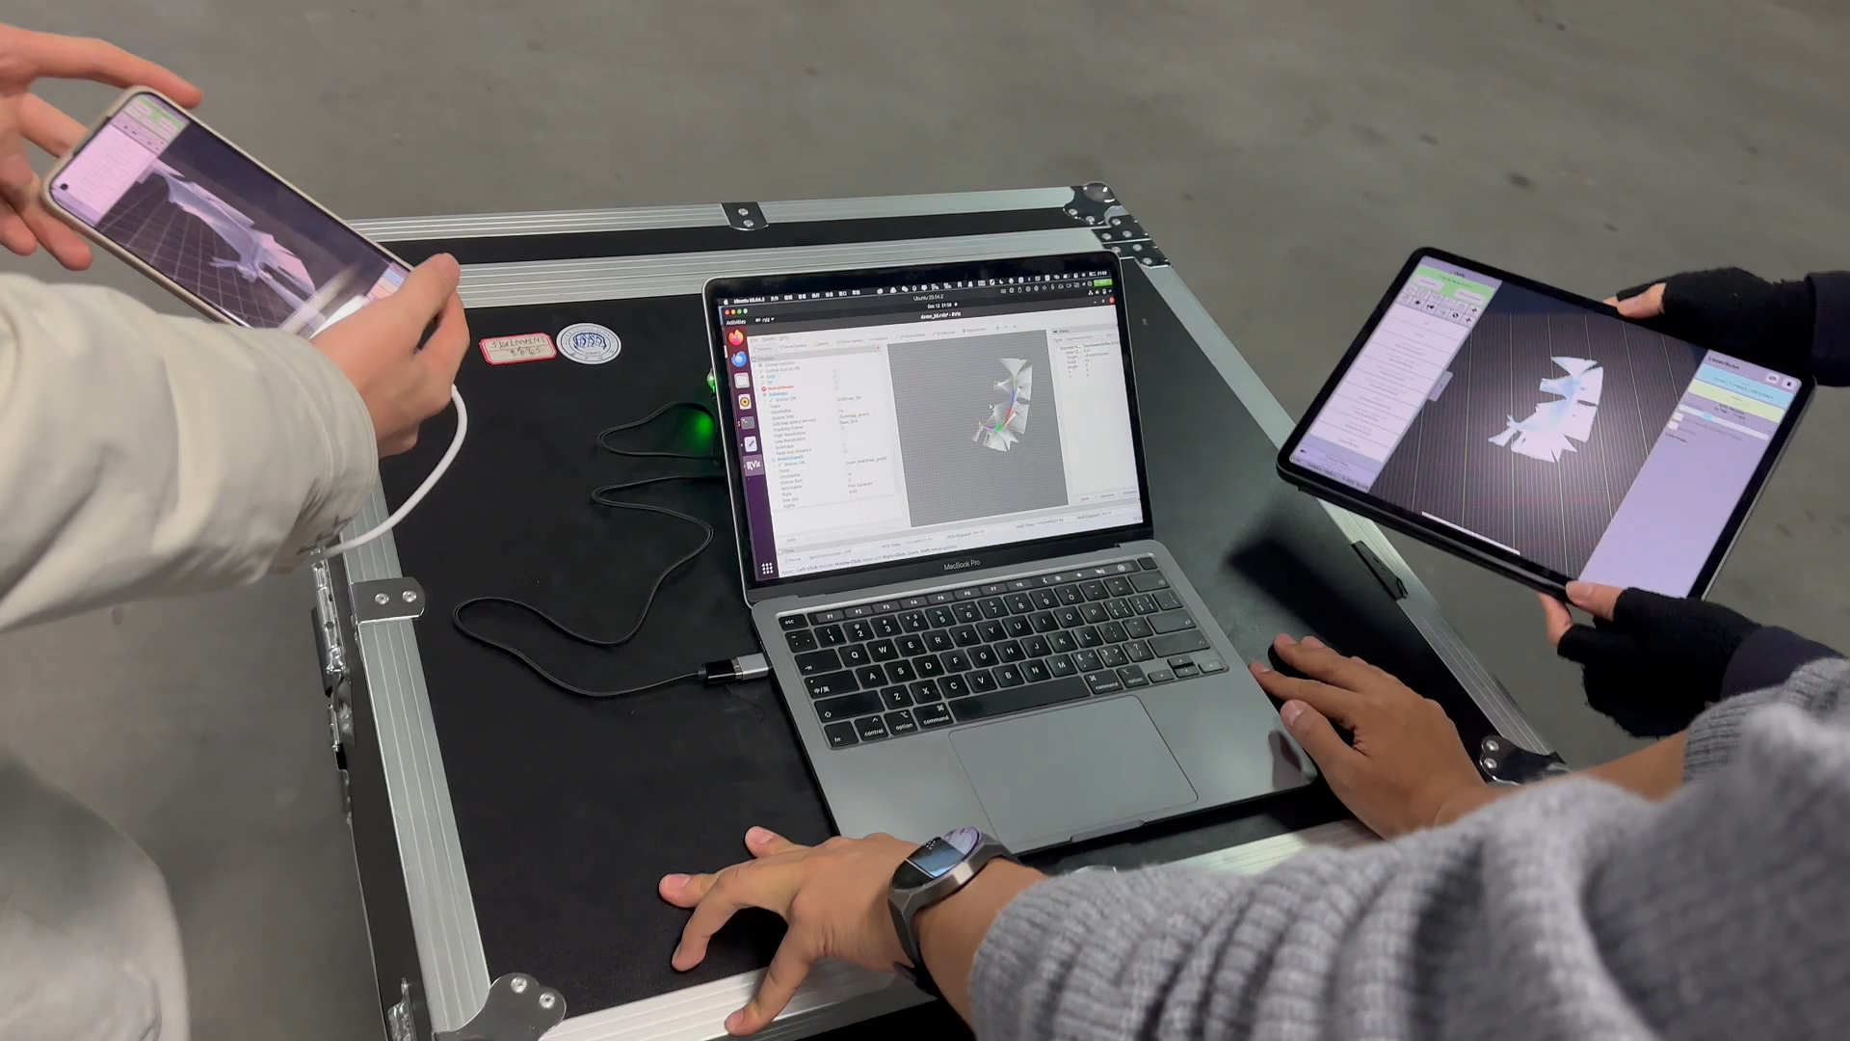
Hardware:
Real-time display of radar scans
RPLIDAR A1M8
Laser Scanning Ranging Radar
Lidar real-time scanning, map building, ROS and mobile communication, mobile display
We can accept the scanning data from the LIDAR in real time, and process the data to generate bag and construct the map. The mobile device can get ROS bag and display on mobile.

Slide 8
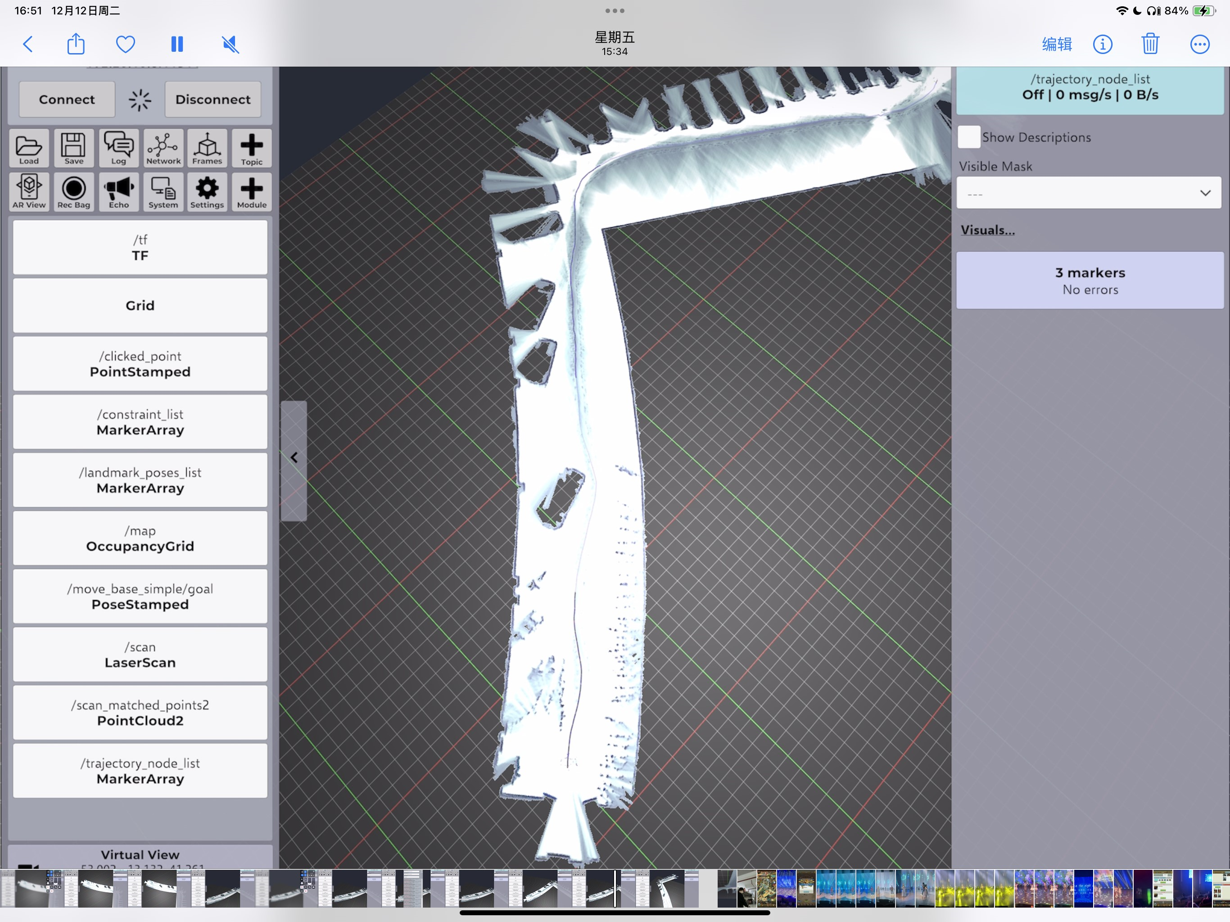
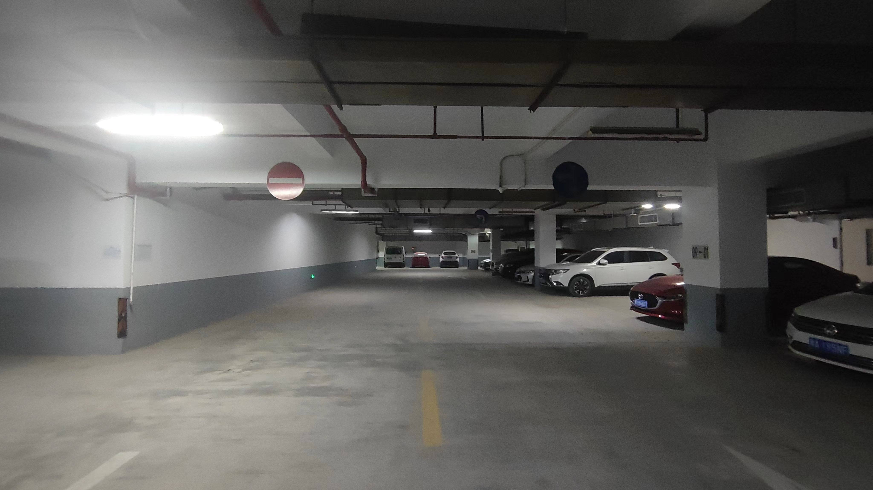
SSE Parking Lot Scan Results
SEE parking lot
Scan result
We can see the corridor and the vehicle

Slide 9
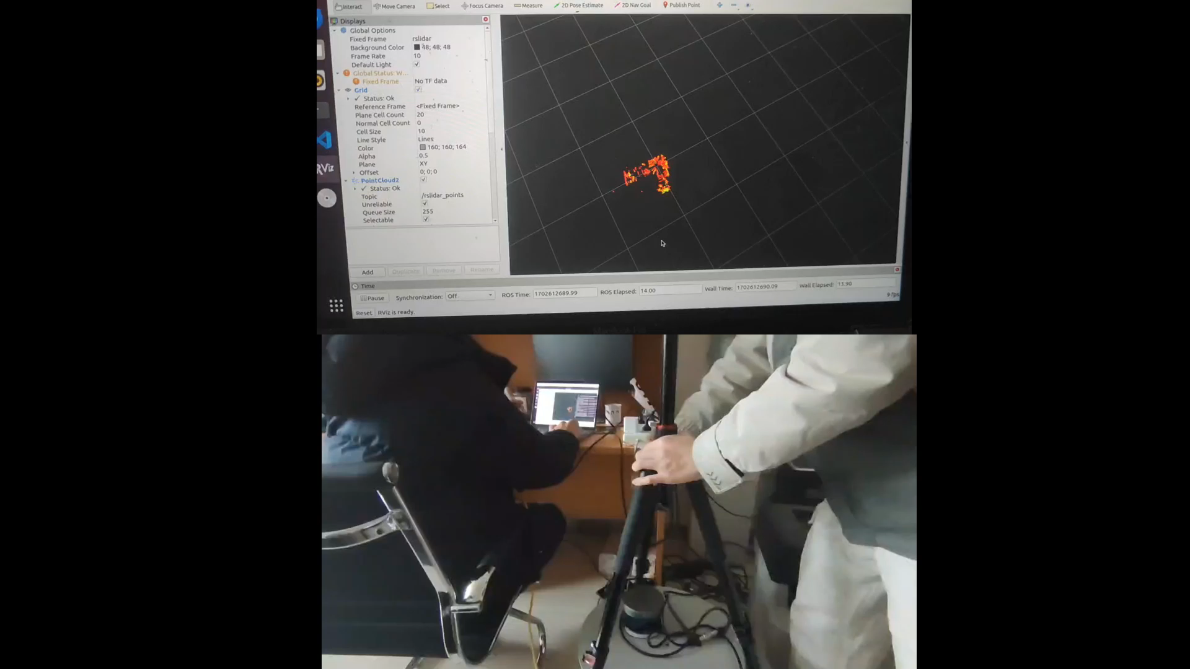
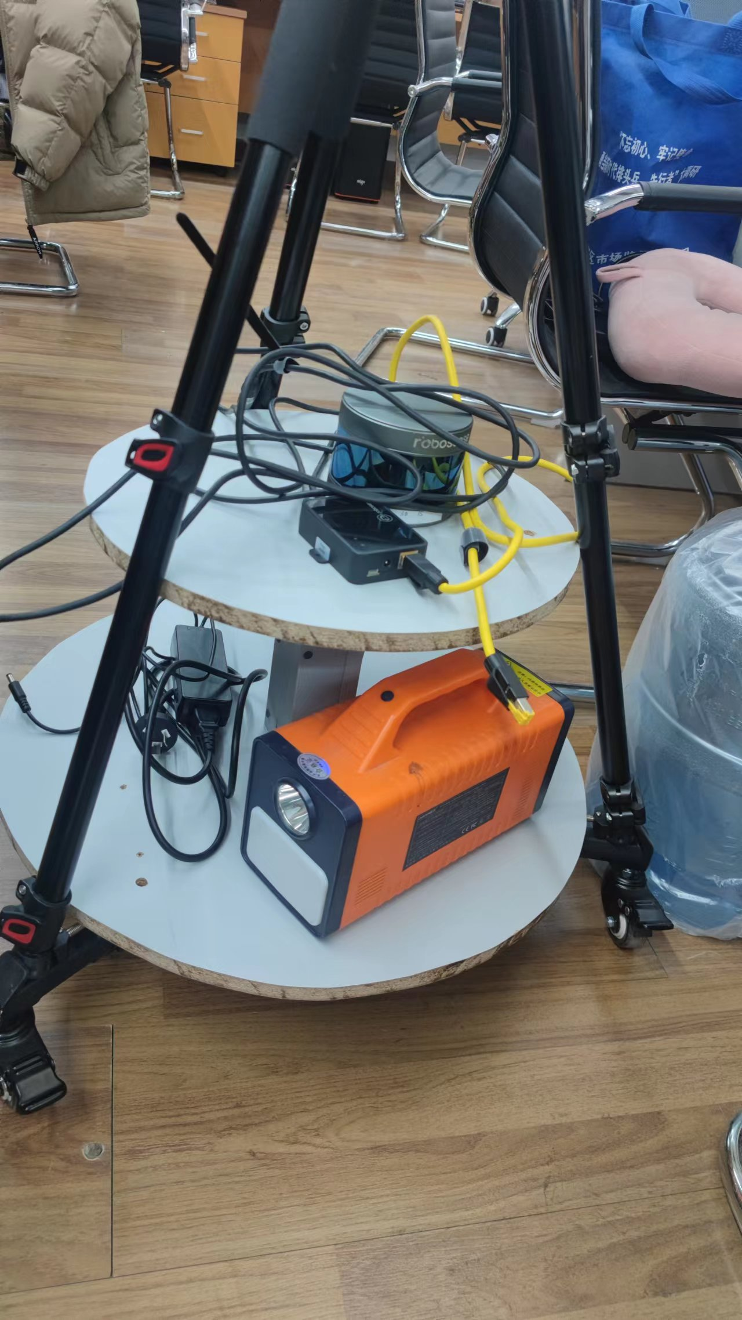
Hardware: 3D LiDAR
Sprint robosenes 16-wire LiDAR
Generating Point Cloud Maps with 3D LIDAR

Slide 10
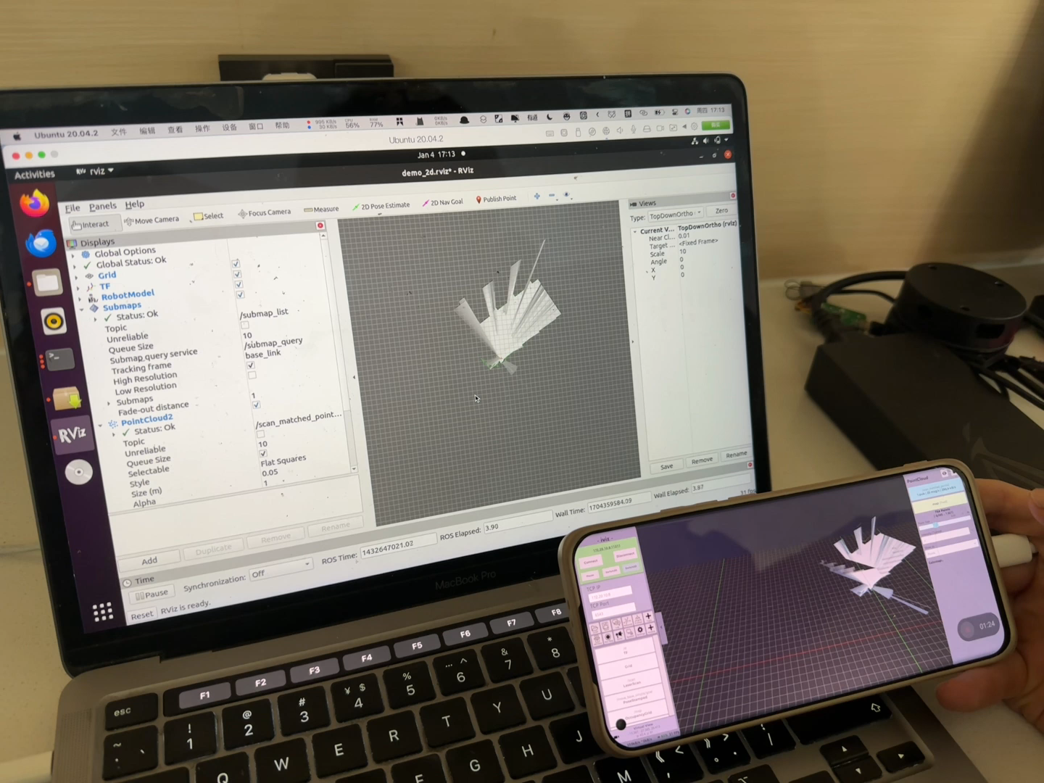
App sends exit command
to the SLAM program
Use the mobile close button to send a command to ROS to end the ROS process.

